Slide 1



Honouring the Seasons of your Life Holistic Retirement Planning and Living as an Elder Workshop

Slide 2

Opening Introductions
Your Name
Background
One thing you’d like to spend time doing during retirement

Slide 3

What this workshop is about
Indigenous concepts of economy and planning for Elder years / “retirement”
Visioning and planning for your Elder years holistically – not just finances
How to support Elders and ANP staff in transitioning to Elder years

Slide 4

Workshop goals
Introduce key concepts to support you in planning holistically for “retirement” and Elderhood
Create a safe space for reciprocal learning; we all learn from each other

Slide 5

Workshop overview
SAMPLE – INSERT AGENDA Morning – opening
Indigenous concepts of economy and Elderhood
Holistic Retirement Planning
Noon Lunch
Pathways to retirement
Transition Planning & Goal setting
Workshop evaluation
Workshop close 4:30
We’ll take breaks too!

Slide 6
Workshop Agreements
Workshop is for everyone: regardless of where you are on your journey (finance, health, etc.)
Listen to others: we can all learn from each other
Non-judgmental: we all have different values & experiences
Confidential: hold as private all stories shared today
Safety: only share if you want. Ask for support if you need it
Questions: all questions are good questions!

Slide 7
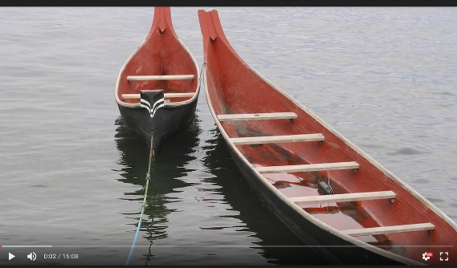

Video 1
Indigenous Concepts of Economy and Elderhood
(15 minute video)
Right click and select Open Hyperlink

Slide 8
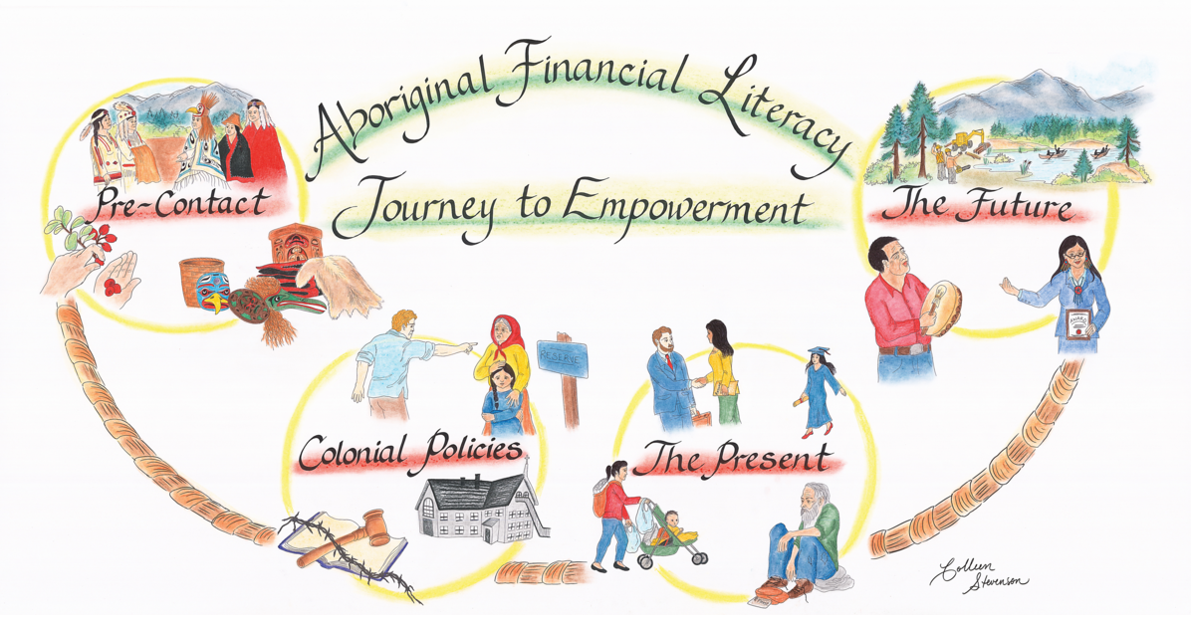
Impacts of Colonization

Slide 9
Break!

Slide 10

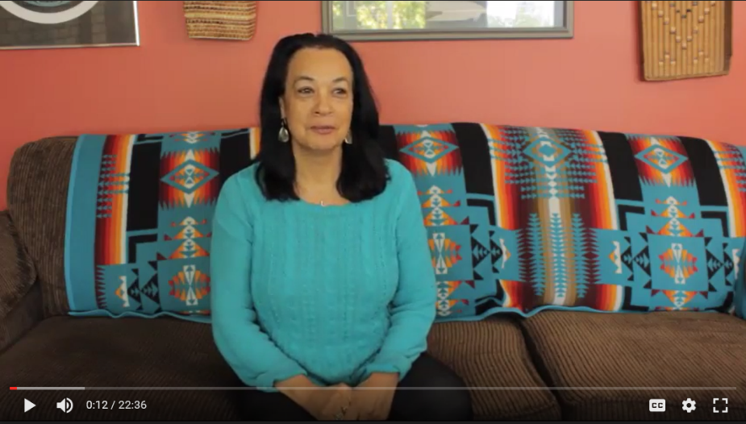
Video 2
The Importance of Planning For Retirement (15 minute video) Right click and select Open Hyperlink

Slide 11
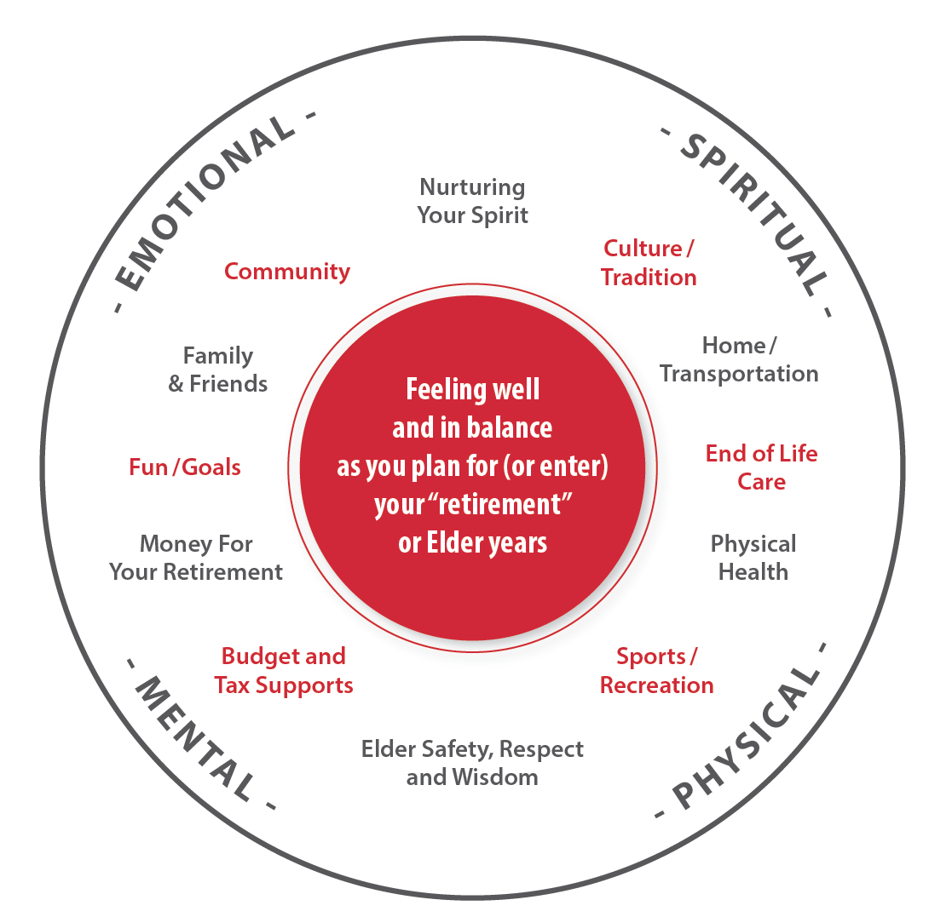
Holistic Retirement Planning – Circle Graphic

Slide 12
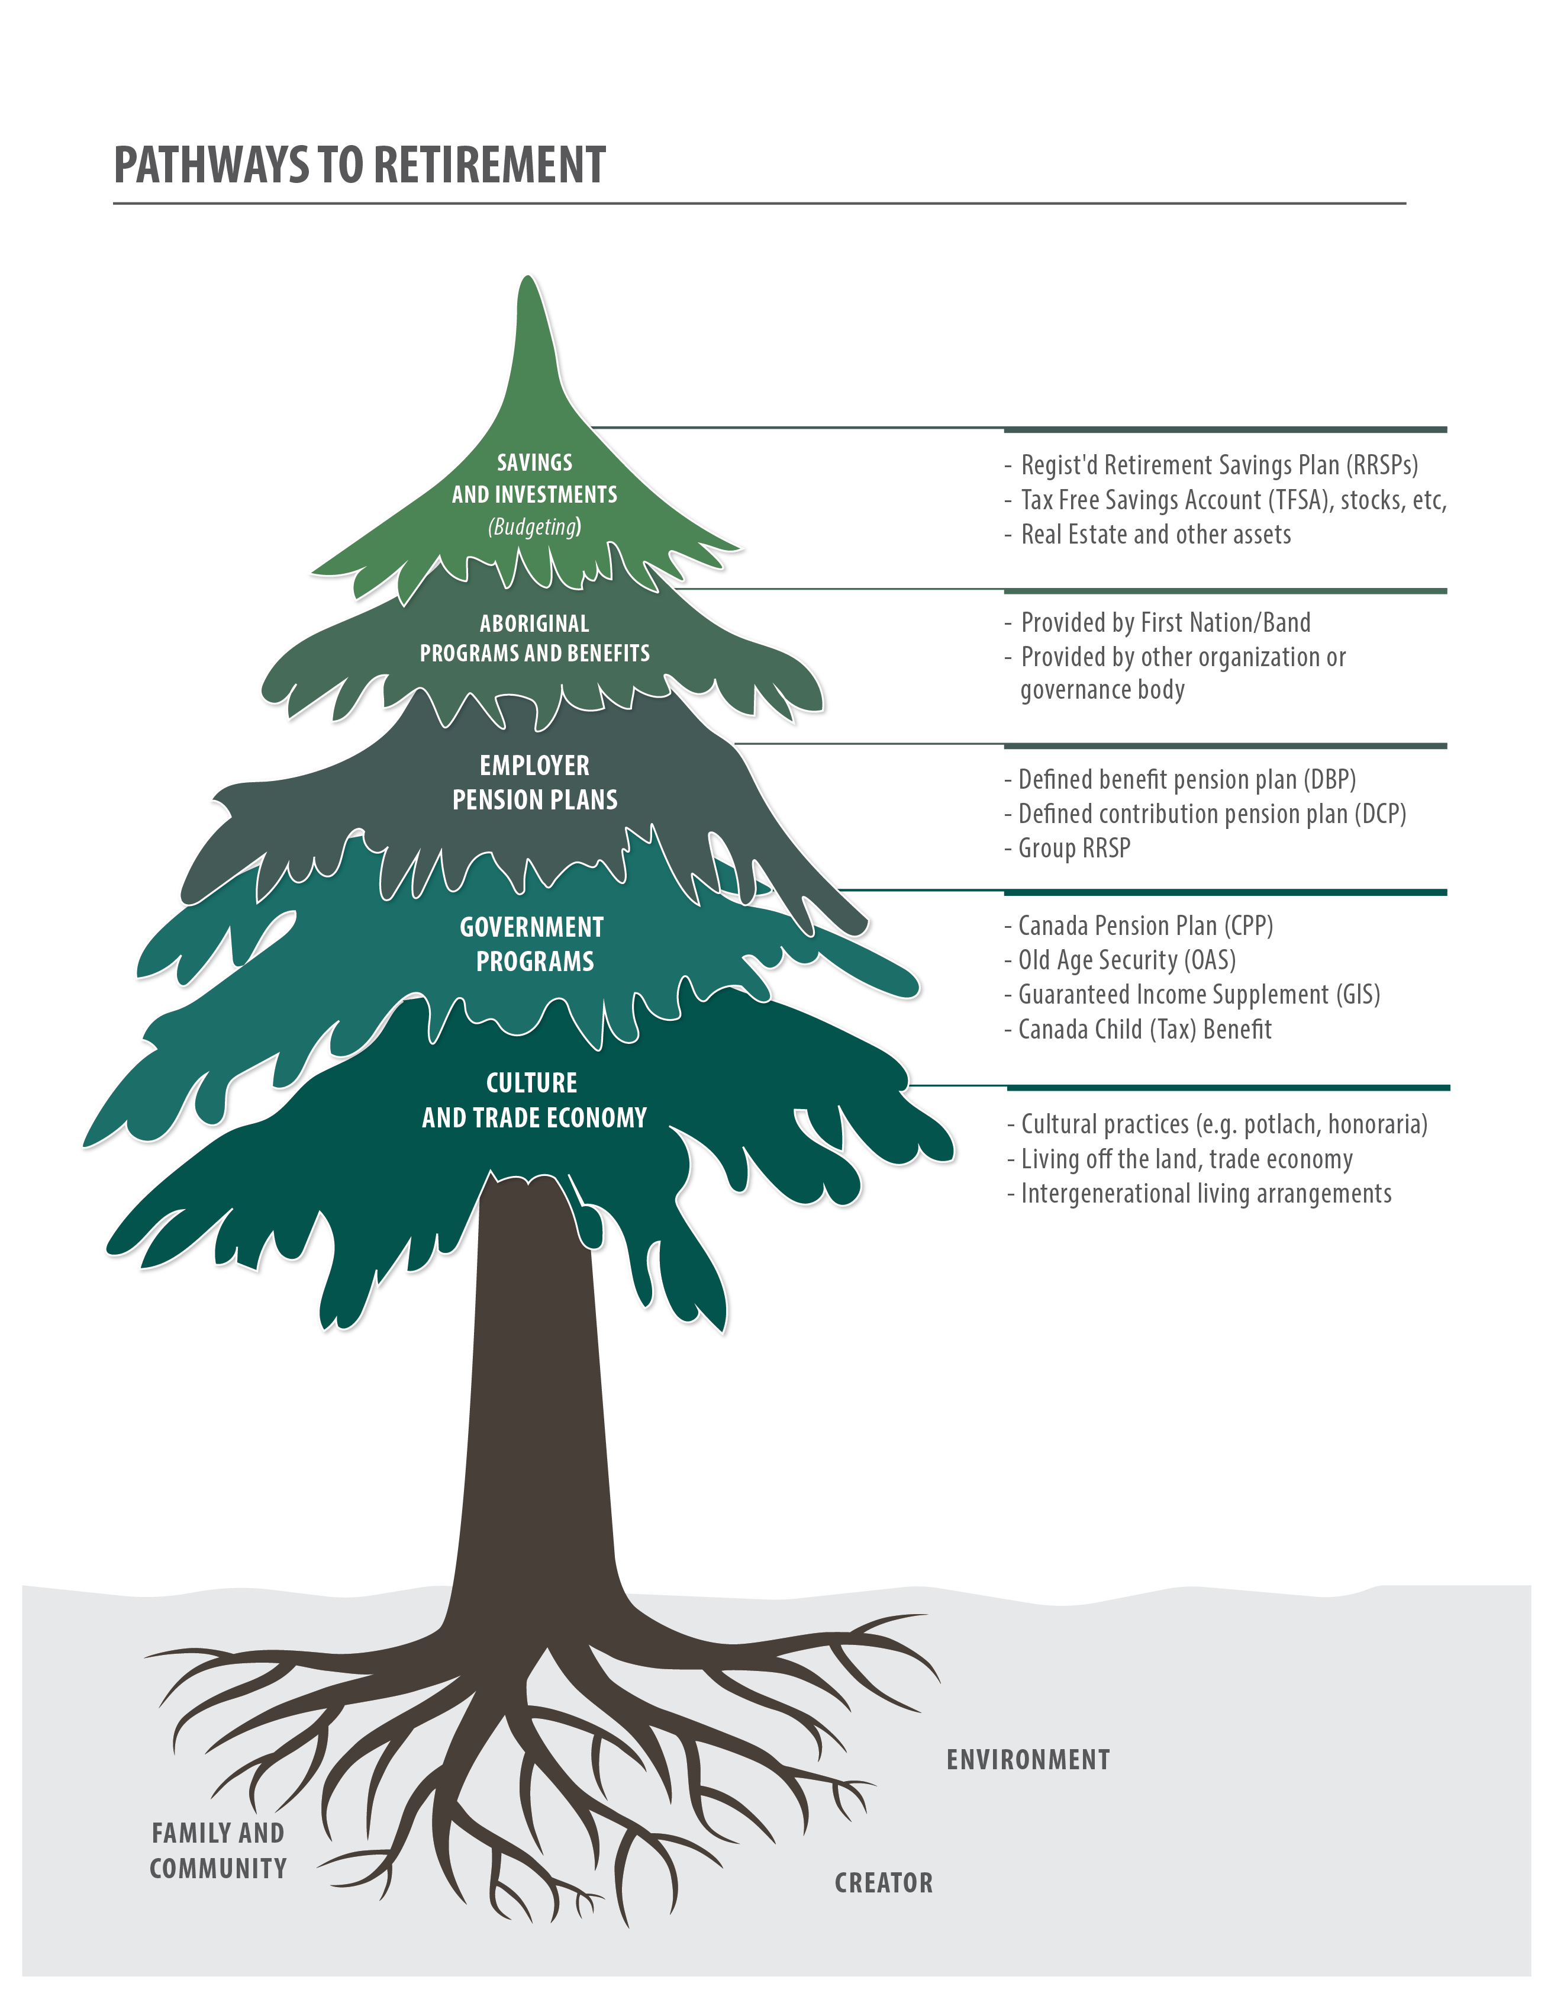
Pathways to Retirement

Slide 13
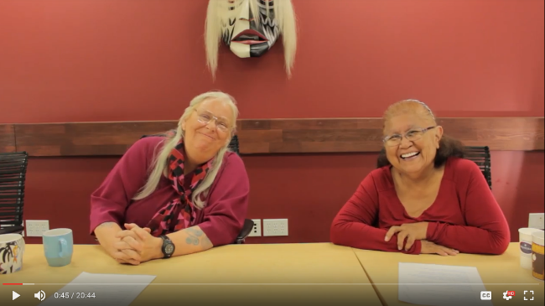
Video 3
Living Well as an Elder and Supporting Elders (15 minute video) Right click and select Open Hyperlink

Slide 14
Closing Thank you!

